Slide 1

Modern App Deep Dive
Universal Windows Platform
Brent Edwards
Principal Lead Consultant
Magenic
Level: Intermediate

Slide 2
Brent Edwards
BrentE@magenic.com
@brentledwards
http://www.brentedwards.net
https://github.com/brentedwards

Slide 3
Universal Windows Platform

Slide 4
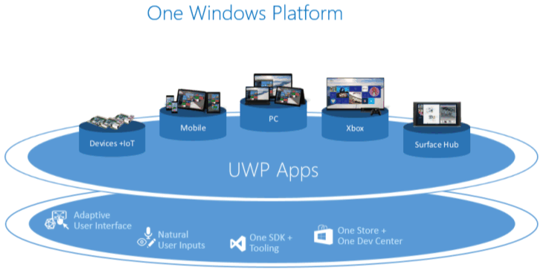
Universal Windows Platform
Source: https://msdn.microsoft.com/en-us/library/windows/apps/dn894631.aspx

Slide 5
UWP Device Families
Windows 8.1/Windows Phone 8.1 target an OS
Windows 10 provides common app platform
Targets Device Families
One package for all

Slide 6
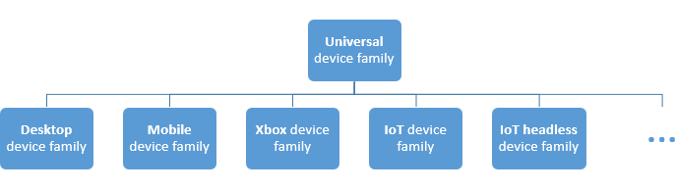
UWP Device Families
Source: https://msdn.microsoft.com/en-us/library/windows/apps/dn894631.aspx

Slide 7
UWP Foundation

Slide 8
Universal Foundation
Layouts
Controls
Styles

Slide 9
Example Controls

Slide 10
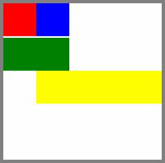
RelativePanel
Source: https://msdn.microsoft.com/library/windows/apps/windows.ui.xaml.controls.relativepanel.aspx

Slide 11
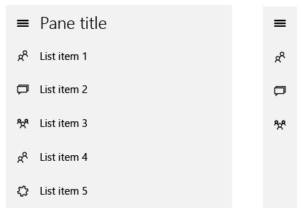
SplitView
Source: https://msdn.microsoft.com/en-us/library/windows/apps/dn997787.aspx

Slide 12
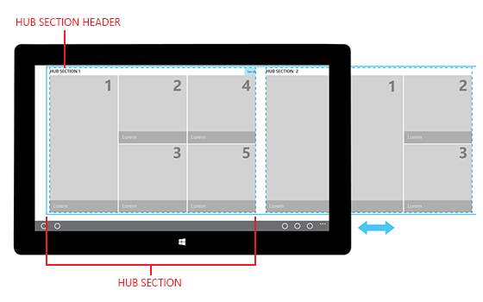
Hub
Source: https://msdn.microsoft.com/en-us/library/windows/apps/dn449149.aspx

Slide 13
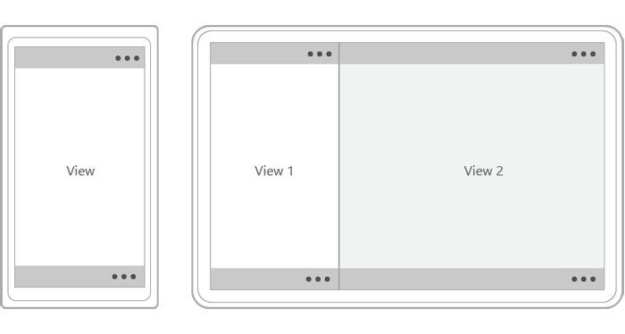
CommandBar
Source: https://msdn.microsoft.com/en-us/library/windows/apps/hh465302.aspx

Slide 14
UI Patterns

Slide 15
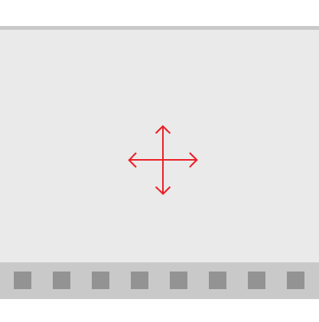
Active Canvas
Source: https://msdn.microsoft.com/en-us/library/windows/apps/dn997761.aspx

Slide 16
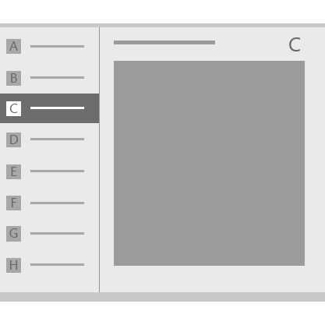
Master/Detail
Source: https://msdn.microsoft.com/en-us/library/windows/apps/dn997765.aspx

Slide 17
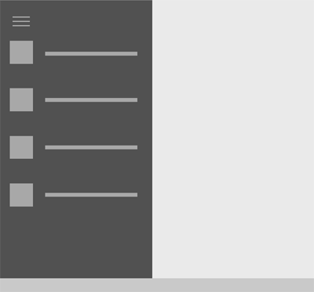
Nav Pane
Source: https://msdn.microsoft.com/en-us/library/windows/apps/dn997766.aspx

Slide 18
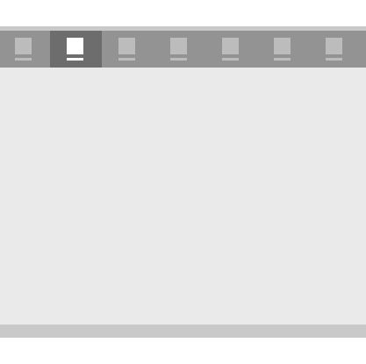
Tabs and Pivots
Source: https://msdn.microsoft.com/en-us/library/windows/apps/dn997788.aspx

Slide 19
Multiple Device Families
Great support for responsive layouts
Lean on
GridView
RelativePanel
StackPanel
Visual States
AdaptiveTrigger

Slide 20
XAML Designer
[DEMO]

Slide 21
MVVM
Model-View-ViewModel

Slide 22
MVVM
View
Presentation
View Model
Presentation Logic
Model
Business Logic

Slide 23
Why is MVVM Cool?
Separates Presentation from Functionality
Promotes Testability
Works great with Data Binding
Easy collaboration with Designers
Makes it easy to change out the View layer!

Slide 24

MvvmCross

Slide 25
MvvmCross
Why use it?
Supports Xamarin.iOS, Xamarin.Android, UWP
Write view model layer once for all platforms

Slide 26
MvvmCross Foundation
Key Stuff
Inherit MvxApplication
Set first View Model or an AppStart
View Models inherit MvxViewModel
Better yet, implement a base ViewModel of your own
UWP
Inherit MvxWindowsSetup (which inherits MvxSetup)

Slide 27
MvvmCross Foundation
Important Note
Keep platform-specific foundation code out of shared projects

Slide 28
MvvmCross Foundation
[DEMO]

Slide 29
Data Binding

Slide 30
Data Binding
What is it?
Ability to bind an element in a view to a property on a view model (or other object)
Binding Modes
OneTime
OneWay
TwoWay

Slide 31
Data Binding
2 Syntax Flavors in UWP
Old School
{Binding Stuff}
Uses reflection to find Stuff property on current DataContext
New School
{x:Bind Stuff}
Compiles the binding using the context of the Page or UserControl

Slide 32
Data Binding
Lots of power
Can bind to single properties or collections of objects
Can provide DataTemplates for collections that further leverage data binding

Slide 33
Implementing Data Binding
View Models implement INotifyPropertyChanged
Raise PropertyChanged events every time data changes or binding should be refreshed
MvvmCross helps with this

Slide 34
Data Binding
[DEMO]

Slide 35
Data Templates

Slide 36
Data Templates
Define presentation of your data
Can give your business objects a “look”
Can leverage data binding
Templates can be
Local to control
Local to Page/UserControl in Resource Dictionary
In Global Resource Dictionary

Slide 37
Data Templates
[DEMO]

Slide 38
Style

Slide 39
Style
Change look-and-feel of controls
Can inherit from existing styles
Two types
Implicit
By Type
Explicit
By Key

Slide 40
Visual States
Another way to change look-and-feel
States can be changed by
Code
Triggers
StateTrigger
AdaptiveTrigger

Slide 41
Style
[DEMO]

Slide 42
Value Converters

Slide 43
Value Converters
Converts data value to format required by UI
How to use it
Implement IValueConverter
Add to resources with a Key
Use it

Slide 44
Value Converters
[DEMO]

Slide 45
Navigation

Slide 46
Navigation
Much simpler with Universal Apps!
Approach is now unified
View-driven with 1 optional parameter
Parameter can be anything
2 Problems
Logic for navigation is generally in ViewModel
ViewModels have to know about Views?!?!
Complex parameter types cause weird problems

Slide 47
Navigation
Solution
Use MvvmCross’s ShowViewModel
Serialize parameters to JSON with MvxJsonConverter
Notes:
MyVoteApp to wire up custom MvxAppStart

Slide 48
Navigation
[DEMO]

Slide 49
Azure mobile services

Slide 50
Azure Mobile Services
Primary Features
Authentication
Push Notifications

Slide 51
Authentication
oAuth done easy
4 Auth Options
Twitter
Facebook
Microsoft
Google
Biggest Drawback
Users have to remember which option they chose

Slide 52
Authentication
Things to consider
Is your app open to anyone?
Does your app need domain authentication?
If so, Azure Mobile Services is probably not the best option for auth

Slide 53
Push Notifications
Deliver info to your users through notifications
Tile
Badge
Toast
Things to consider
How can your Tile be more Live?
What info to show in Toasts?

Slide 54
Azure Mobile Services
[DEMO]

Slide 55
Azure blob storage

Slide 56
Azure Blob Storage
A Couple of Options
Nuget Package
Windows Azure Storage
REST API

Slide 57
Windows Azure Storage Library
Nuget Package
Gives access to containers and blobs
Can use credentials directly
Or, better yet…

Slide 58
Storage Access Security (SAS)
What is it?
Temporary key
Has built-in expiration
SAS keeps credentials out of client
Recommend generating on server

Slide 59
REST API
Provides all Blob Storage functionality
Create containers
Upload blobs
Can use credentials directly
Better yet, use SAS

Slide 60
Azure blob storage
[DEMO]

Slide 61
Info
MyVote Source
https://github.com/magenic/myvote

Slide 62
Questions?

